Slide 1
Java 8 – SE 1 Presentation
Chapter 4 – Methods and Encapsulation

Slide 2
Previous questions leftover
- Question 1: (code illustration snippet 1)
Answer:
(Rewind: Last time we mention that String pool is in Stack space, however, String pool is a ...)
The reason why first part print "false" is because with the class "String", Java has a special rule is that the String ... operator will implicitly create ... (if the result is not ...) (link note 1).
It defines that a String object will ... unless the expression is ... (link note 2)
Java defines constant expression as ... (link note 3)
=> If our expression contains ... => It will automatically create ..... Otherwise, the result will automatically ... to the String pool
- Question 2: (code illustration snippet 2)
Answer: About the relationship between static ... and static ... that we disclosed previously, we can assume that this works because ... of element. But the truth behind it is because of a Java characteristic called "..." (link note 4)
There are ... rules required for this example to encounter ... However, in our example, only ... rules are satisfied
(link illustration)
=> Therefore, our code is worked (luckily)
Notes:
Note 1: https://docs.oracle.com/javase/specs/jls/se8/html/jls-4.html#jls-4.3.3:~:text=The%20string%20concatenation%20operator%20%2B%20(%C2%A715.18.1)%20implicitly%20creates%20a%20new%20String%20object%20when%20the%20result%20is%20not%20a%20constant%20expression%20(%C2%A715.28).
Note 2: https://docs.oracle.com/javase/specs/jls/se8/html/jls-15.html#jls-15.18.1:~:text=The%20String%20object%20is%20newly%20created%20(%C2%A712.5)%20unless%20the%20expression%20is%20a%20constant%20expression%20(%C2%A715.28).
Note 3: https://docs.oracle.com/javase/specs/jls/se8/html/jls-15.html#jls-15.28:~:text=serializable%20%22by%20default%22.-,15.28.%C2%A0Constant%20Expressions,-ConstantExpression%3A
Note 4: https://docs.oracle.com/javase/specs/jls/se8/html/jls-8.html#jls-8.3.2:~:text=Test%20is%20created.-,8.3.3.%C2%A0Forward%20References%20During%20Field%20Initialization,-Use%20of%20class

Slide 3
Previous questions leftover
- Question 3: Stack VS Heap, which one will be prioritized for Garbage collection ?
Answer (according to DigitalOcean):
- Heap space is a ... used by ... while Stack space is a ... used by only ...
– Heap space is accessible from ... while Stack space is only accessible from ...
– Stack space is managed in ... manner
– Heap space is much more ... when ...
- Stack space lifetime is ... while Heap space lifetime is ...
=> Assume that ... is prioritized than ...
Notes:
Note 5: https://www.digitalocean.com/community/tutorials/java-heap-space-vs-stack-memory#difference-between-java-heap-space-and-stack-memory

Slide 4
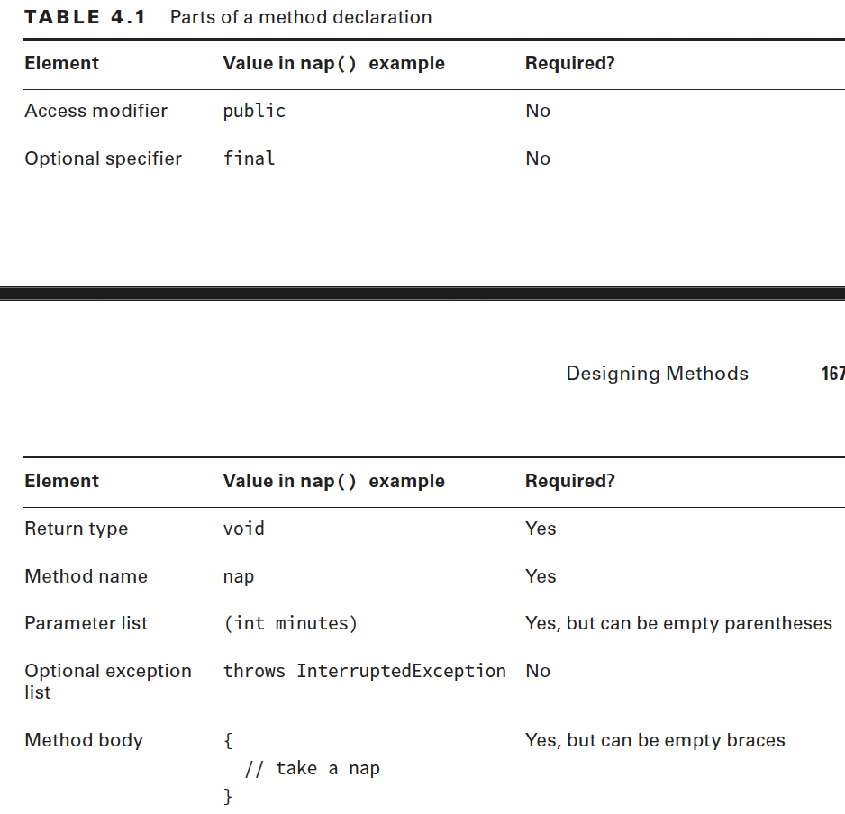
Designing method
- Explain each components in a method declaration (code illustration snippet
- Optional specifiers is the word used for keyword ... and ...

Slide 5
Designing method
- Explain all types of access modifiers
(Note: ... keyword is used in Interface) – ask question (Q7)
(code illustration snippet 4)
- There are 6 types of optional ... in Java, and only ... of them we are using: ..., ... and .... The other 3 are "synchronized", "native", "strictfp"
(code illustration snippet 5)
- Explain about return type of method
(code illustration snippet 6)
- Explain about the rule of return value VS return type of the object ? (all cases: primitive, wrapper and reference types)
(code illustration snippet 7)
- Explain about method name
- Explain about parameter list
- What is optional Exception list ?
– What is method body ?

Slide 6
Applying Access modifier
- What is "Private" ?
– What is "Default" ?
– What is "Protected" ?
Note: Accessing protected member has 2 rules
+) Must be on the same ...
+) If different in ..., they must be in a ... relationship
However, the 2nd rule has a special condition: Only ... variable and its ... variable can access. Otherwise, reference variable from ... or even other classes that ... are prohibited to ...
This happen because if Java allows these variable to have ... to each other ... => Break ...
(Claude AI code illustration)
- What is "Public" ?

Slide 7
Designing Static methods and Fields
- Book question: Does each class have its own copy of the code ?
Answer: Each class only has the copy of ..., ...
However, many copies of ... methods ... can be created => have many space on ... memory. The same thing also apply to the ... method
- We have already seen a static method before, the "..." method => We could call it from ... using ...
(code illustration snippet 8) (ask question – Q2)
– What is the purposes of static method ?
– How to calling a static method or static field ?
- What is the difference between static and instance ?
- Static variable has 2 main purposes:
+) 1: Serve as a ... variable for all ... in a class => Usually ...
+) 2: Serve as a ... => Always ... => New naming convention: ?
(code illustration snippet 9)
(code illustration snippet 10)

Slide 8
Static initializer
- Explain what is static initializer ?
- Note: According to Java specification, Static initializer will be ... (link note 6)
Rewind: The static initializer before the field declaration example, we have seen an example where we directly assign ... => Java will automatically ... the field with the value ... (link note 7 – this one need verification) (ask question, 4 – 5 – 6)
- Instance initializer is ... => We should ... and use ... instead
- Static initializer however have some .... For example, when we need to initalize an ...
Notes:
Note 6: https://docs.oracle.com/javase/specs/jls/se8/html/jls-8.html#jls-8.7:~:text=%C2%A711.2.3.-,8.7.%C2%A0Static%20Initializers,-A%20static%20initializer
Note 7: https://docs.oracle.com/javase/specs/jls/se8/html/jls-8.html#jls-8.3.2:~:text=discussion%20and%20examples.-,8.3.2.%C2%A0Field%20Initialization,-If%20a%20declarator

Slide 9
Static import
- Just like normal import, we can also do static import
– There are some ... of static import, for example when we need to ... from another class
(Note: Static import could be ... => In large program, if we use ... => we can't know where does they come from
- Static import isn't limiting to import ..., it can also import ...
(code illustration snippet 11)
- If we add ... that has a name that matches with ... => Java will prioritize the ... than the ...
(code illustration snippet 12)
Notes:
Note 6: https://docs.oracle.com/javase/specs/jls/se8/html/jls-8.html#jls-8.7:~:text=%C2%A711.2.3.-,8.7.%C2%A0Static%20Initializers,-A%20static%20initializer
Note 7: https://docs.oracle.com/javase/specs/jls/se8/html/jls-8.html#jls-8.3.2:~:text=discussion%20and%20examples.-,8.3.2.%C2%A0Field%20Initialization,-If%20a%20declarator

Slide 10
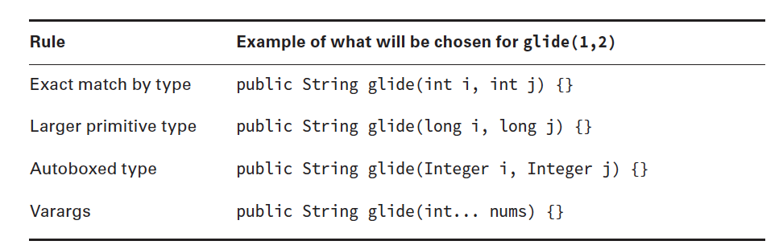
- Explain about pass by value and pass by reference
(code illustration snippet 13 – 14 – 15)
- Explain what is method overloading ?
(code illustration snippet 16 – 17 – 18)
- When ...ing a method, Java will prioritize ... more than ... (unless there are no options left)
(code illustration snippet 19)
(Note: Only ... are allowed in method, ... are not allowed in method => Also answered the previous question about Wrapper constructor: "Why we can't pass ...")
(code illustration snippet 20 – 21)
- The reason why we have this order in this table below is ... was born ...
Notes:
Note 6: https://docs.oracle.com/javase/specs/jls/se8/html/jls-8.html#jls-8.7:~:text=%C2%A711.2.3.-,8.7.%C2%A0Static%20Initializers,-A%20static%20initializer
Note 7: https://docs.oracle.com/javase/specs/jls/se8/html/jls-8.html#jls-8.3.2:~:text=discussion%20and%20examples.-,8.3.2.%C2%A0Field%20Initialization,-If%20a%20declarator

Slide 11
(code illustration snippet 22) (ask question Q3)
Notes:
Note 6: https://docs.oracle.com/javase/specs/jls/se8/html/jls-8.html#jls-8.7:~:text=%C2%A711.2.3.-,8.7.%C2%A0Static%20Initializers,-A%20static%20initializer
Note 7: https://docs.oracle.com/javase/specs/jls/se8/html/jls-8.html#jls-8.3.2:~:text=discussion%20and%20examples.-,8.3.2.%C2%A0Field%20Initialization,-If%20a%20declarator

Slide 12
Chapter 4 – Continued
- Question from previous lession: Why can't we use implicit widening in boxing primitive type ?
Answer: According to Java Specification, boxing primitive is considered as "Boxing ..." and it defines Boxing ... as:
...-> ...
...-> ...
...-> ...
...-> ...
...-> ...
...-> ...
... -> ...
...-> ...
null -> null (ask question about this, Q6)
=> Therefore, we can't pass ... but we must ...

Slide 13
Creating Constructor
- Explain how to create a constructor ?
– When Java detect the "new" keyword, its ...
– The "this" variable is .... However, in some cases, there will be ... => If we don't specify ... using "this" => Java will refer to ... => ...
(code illustration snippet 23)
(code illustration snippet 24)
– Explain what is "default constructor" ?
(code illustration snippet 25 – 26)
-Explain what is Constructor overloading ? and how to do it ?
(code illustrations snippet 27)
- Explain what is Constructor chaining ? (also mention about a special rule when using Constructor chaining ?)
(code illustrations snippet 28 – 29)
- Explain what is "final field" ?
(code illustration snippet 30)

Slide 14
Creating Constructor
- Remember, the order of initialization of each member in the class is:
... -> ... -> ...
(code illustration snippet 31 – 32 - 33)

Slide 15
Encapsulating Data
- Explain about data encapsulation ? (what should we do ?, what is the purposes of doing encapsulation ?)
- When using data encapsulation, the ... convention for ...er and ...er must follow a speical type of convention called ...
(code illustration snippet 34 – 35)

Slide 16
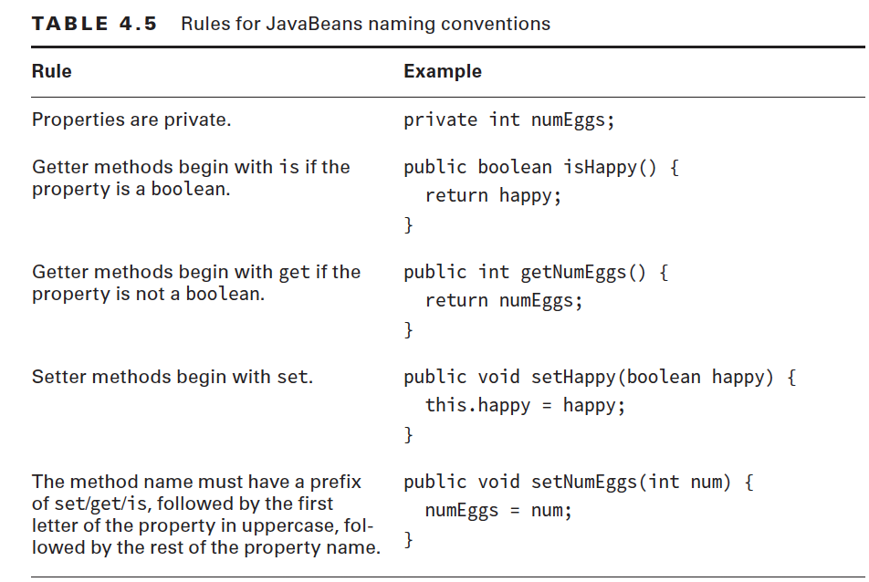
Encapsulating Data

Slide 17
Encapsulating Data
(code illustration snippet 36)
- If we want to create an immutable class, we could set the field to ... and remove ...er
(code illustration snippet 37)
- However, there are some cases where the class looks like "immutable" but turns out, it is not
(code illustration snippet 38)
- As we have seen, the class is not totally immutable. To make it immutable, we have 2 options:
+) We could return a new ... when user try to ... the method getBuilder() => this is called a "..."
+) return an ... object

Slide 18
Writing simple lambda
- The core of Java is .... However, Java 8 has also developed a new ... of ... called ...
- Functional programming is a ... style of ..., it belongs to a larger group called ...
- Declarative programming is a style of ... where we focusing on ... without specifying ...
- Functional programming is targeted on applying more ... rather than using ...
- Functional programming use something called ... to write ....
- Basically, lambda is like a ... of codes that can be ... around. We can imagine lambda is like an ... method (it has ..., ... but not ...) => we could say that lambda is like a ... that can ... around.
- For example, there are many ways to ... ages of a ... and a .... If we want to create a method that accept a ... (such as age()) as a ... => We must create 2 ... and create 2 ... methods for each of the .... However with lambda, we just need the ... to ... the ages to be passed in as a .... (require verification on this explanation, Q1)
(code illustration snippet 39) - this code will print out the list of Animals (based on some criterias)
- Although we will mention about interface later, but now we will assume that interface is ...
- The method print() is ... => ... design because it doesn't care about which type of ... we are ... right now. However, if we want to check if the ... can ..., we have to create another ... and another ... => ... design
– Instead, why can't we just specify the ... => We can do it using lambda
(code illustration snippet 40)
- If we can do this with ..., why can't we do with others ? (code illustration snippet 41)

Slide 19
Writing simple lambda
- Lambda use a special concept called .... It means that when Java detect a ... call inside another ... call => it will call the ... one. However, with ..., the ... one won't be called unless the ... one get called
=> The order of lambda execution is:
... get called -> the ... method inside the ... get called => it will refer to the ... passed in as ... (ask teacher to verify this)

Slide 20
Lambda syntax
- One of the ... lambda that we can write is ...
- The lambda that we just illustrated is equilvalent to ... Java that we should invoke a ... on a ... reference, which will ... a ... value (as a result of invoking ...) but how can Java understand this ?
- Java will base on the ... when passing ... to the ...
- Java will ... our lambda with the ... of the interface ... in the .... Then after that, it will ... our lambda to the ... in the interface
– It will compare our ... with ... in the interface (If that ... accept an ... as a parameter => our ... must also ..., if the method ... => our ... must also ...)

Slide 21
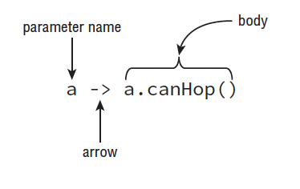



Lambda syntax
- This picture below is the structure of a ... (... version)

Slide 22
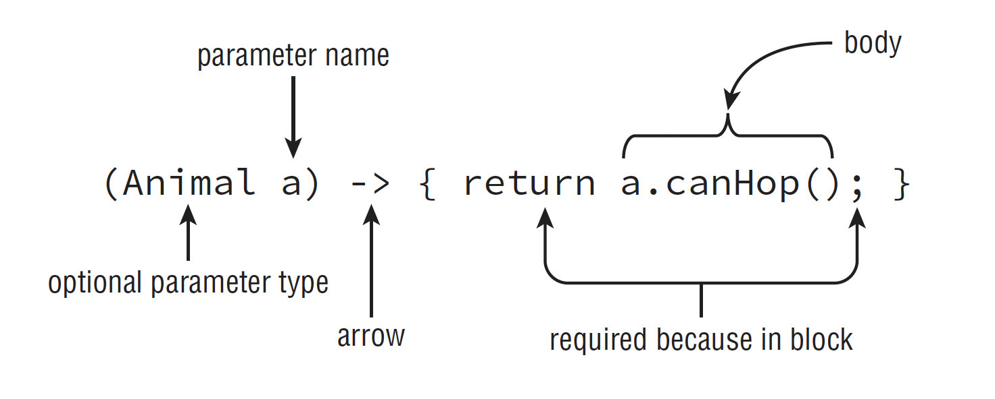



Lambda syntax
- This picture below is the structure of a ... (... version)

Slide 23
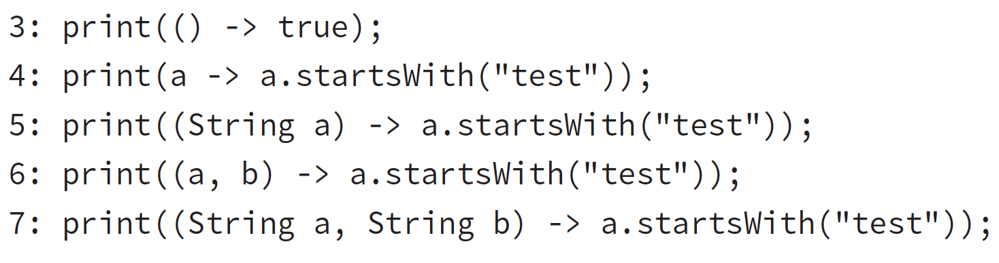
Lambda syntax
- The ... for the parameter can be ... but with ... special rules:
+) There is only ...
+) There is no ...
- We can also ... the curly bracket, but with ... rules:
+) The bracket can be ... if there is only ...
+)If the bracket is ..., the ... keyword must be ... and the ... sign must also be ...
+)If the bracket isn't ..., the ... must be maintained
+) Look at these lambda example, check if there any problem

Slide 24
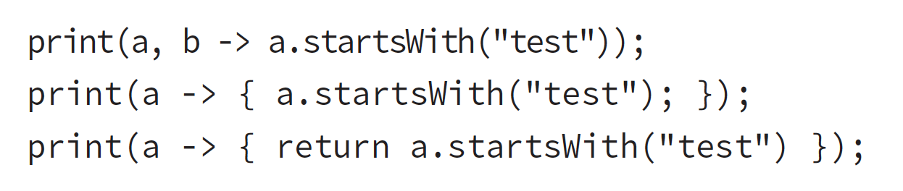
Lambda syntax
- Note: On line 6 and 7, we can see that there are ... but there is only ... is used. Java ... this and therefore we can ... many of them and use how many as we want
- What is the problem of each of these lambda down here ?
(ask question about the real world scenario section – Q2)

Slide 25

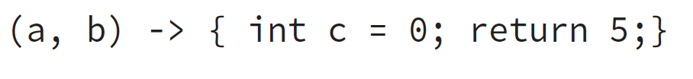
Lambda syntax
- The ... of lambda is considered as ... => Any other variable ... that has the ... name with lambda ... will be prohibited => if trying to do that => ...

Slide 26
Lambda Predicate
- We have seen lambda is ... when doing ...
– However, what happen if we want to test on more ... ?
- Luckily, Java understand this problem => create Predicate ...
(Java API illustration), also explain what is the "T" appears in the API
(ask question - Q3)
(code illustration snippet 42)
- Java also ... to some other ... in their API
(Java API illustration + code illustration snippet 43)

Slide 27
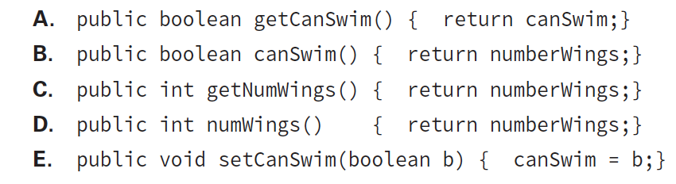
Q&A section
- Question 1, from review question
(check my package in directory, the question is on the comment)
- Question 2, from review question
why does option C is considered as valid answer ?

Slide 28
Q&A section
- Question 3 (check Q3 class in directory, the question is in the note)

